Slide 1
Element Family Project
By: Joshua Sullivan

Slide 2
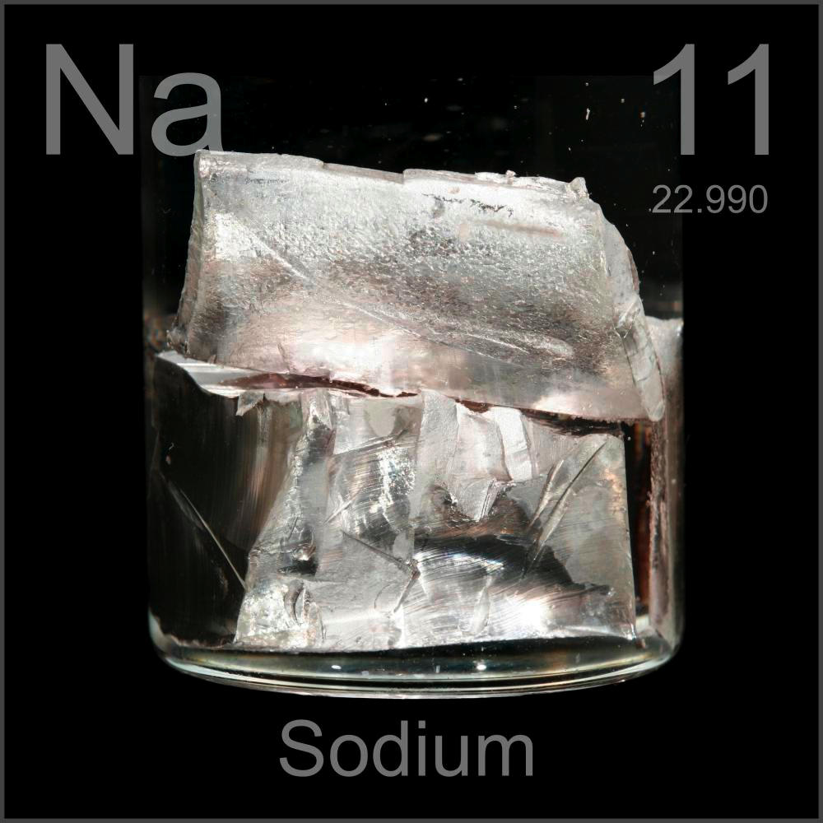
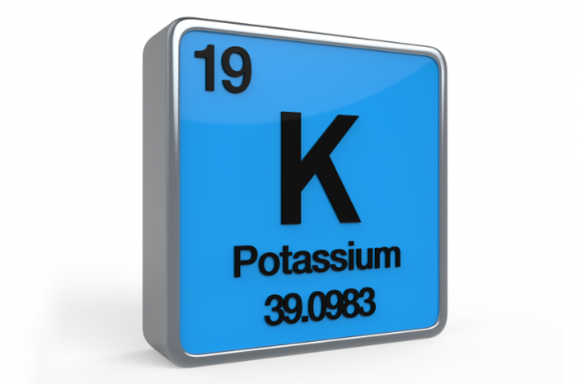
Elements within the Alkali Metals
Lithium (Li)
Sodium (Na)
Potassium (K)
Rubidium (Rb)
Cesium (Cs)
Francium (Fr)

Slide 3
Chemical and Physical Properties
Alkali metals have very similar chemical and physical properties.
They are very shiny, and they are soft enough to cut with a butter knife.
They all act violently with water.
Good conductors of heat, low melting points.

Slide 4
Example Video
https://youtu.be/I8tOtZKpi04

Slide 5
Natural Occurrences
Alkali metals are not found freely in nature.
Alkali metals can’t be found in the body.

Slide 6
Elements Uses
Lithium is used for making batteries, lubricants.
Sodium is used for making medicine, and agriculture.
Potassium is used for making glass, and soap.
Rubidium is used for catalyst, and photocells.
Cesium is used for removing air races in vacuum tubes.
Francium has no uses.

Slide 7
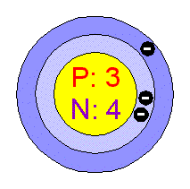
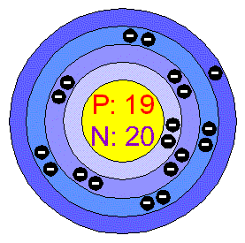
Bohr Model
Lithium’s bohr model:
Potassium bohr model:

Slide 8
Electron Configuration
Lithium:
Potassium:

Slide 9
Quiz Questions
Which of the following is true about Alkali Metals?
Highly Reactive Metals.
Poor conductors of heat.
Alkali metals was discovered by Dalton.
None of the above.

Slide 10
Quiz question #2
Which is an Alkali Metal?
Sodium
Gold
Carbon
Lead

Slide 11
Quiz question #3
How many Alkali Metals are in the Periodic Table?
1
5
6
24

Slide 12
Quiz questions #4
Write the Electron Configuration of Rubidium(Rb).

Slide 13
Quiz question #5
Draw the Bohr Model of Lithium (Li).

Slide 14
Quiz Answers
Answer A
Answer A
Answer C
Fhn
ghg

Slide 15
Bibliography
www.hobart.k12.in.us
www.chemicalelements.com
www.scienceclarified.com

